Slide 1

Bell Work: Evaluate, if you can.
$1.) arccos\left(\frac{\sqrt{2}}{2}\right)$
${2.) cos}^{−1}\left(−1\right)$

Slide 2
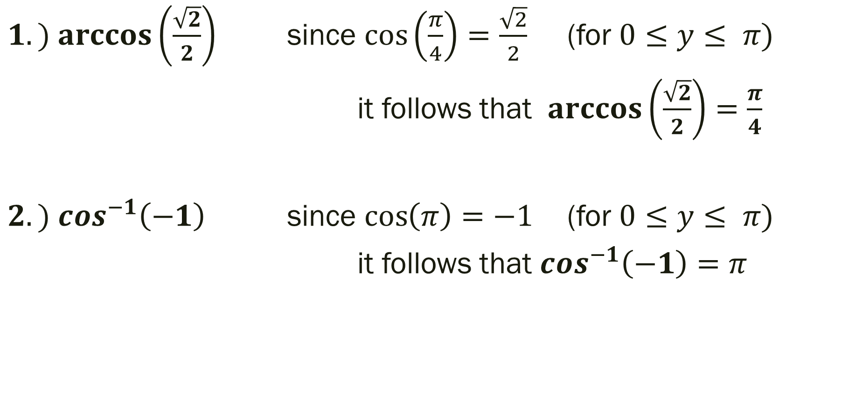
Bell Work: Simplify
$1.) arccos\left(\frac{\sqrt{2}}{2}\right)$ since $\cos\left(\frac{π}{4}\right)=\frac{\sqrt{2}}{2}$ (for $0≤y≤ π)$
it follows that $\arccos\left(\frac{\sqrt{2}}{2}\right)=\frac{π}{4}$
${2.) cos}^{−1}\left(−1\right)$ since $\cos\left(π\right)=−1$ (for $0≤y≤ π)$
it follows that $\cos^{−1}\left(−1\right)=π$

Slide 3
From last time…
Page 316 #9, 11, 13, 19-24, 37-44, 45-51 (odd), 69, 71, 97
Get a Head Start…
Page 347 #1-4, 5-9 (odd), 23-27 (odd), 43, 49-51, 55, 105, 111

Slide 4
Pre-calc trig
Day 36

Slide 5
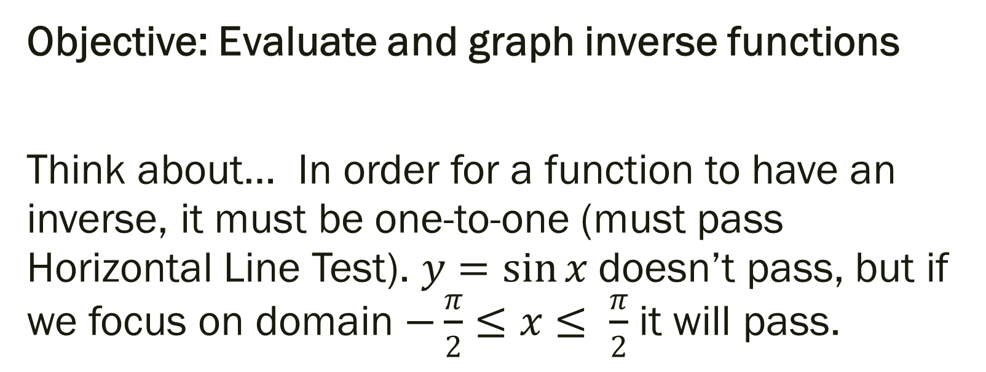
4.7 Inverse Trig Functions
Objective: Evaluate and graph inverse functions
Think about… In order for a function to have an inverse, it must be one-to-one (must pass Horizontal Line Test). $y=\sin{x}$ doesn’t pass, but if we focus on domain $−\frac{π}{2}≤x≤ \frac{π}{2}$ it will pass.

Slide 6
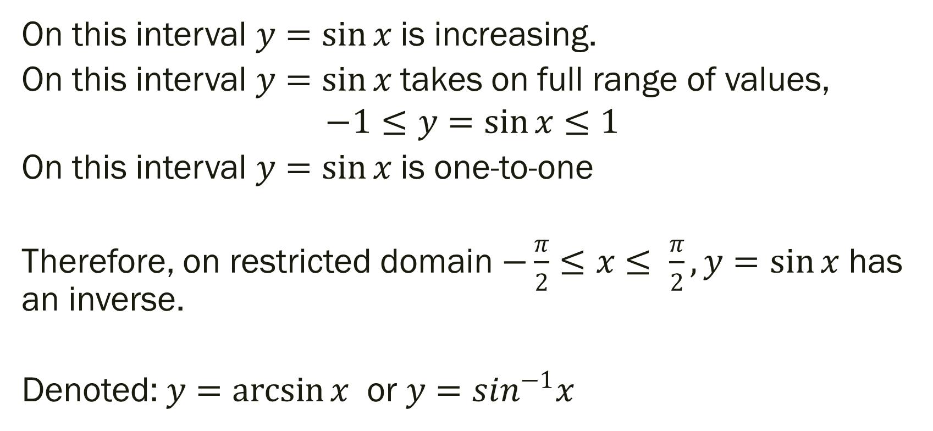
Inverse of Trig Functions (explained with sine)
On this interval $y=\sin{x}$ is increasing.
On this interval $y=\sin{x}$ takes on full range of values,
$$−1≤y=\sin{x}≤1$$
On this interval $y=\sin{x}$ is one-to-one
Therefore, on restricted domain $−\frac{π}{2}≤x≤ \frac{π}{2}, y=\sin{x}$ has an inverse.
Denoted: $y=\arcsin{x}$ or $y=sin^{−1}x$

Slide 7
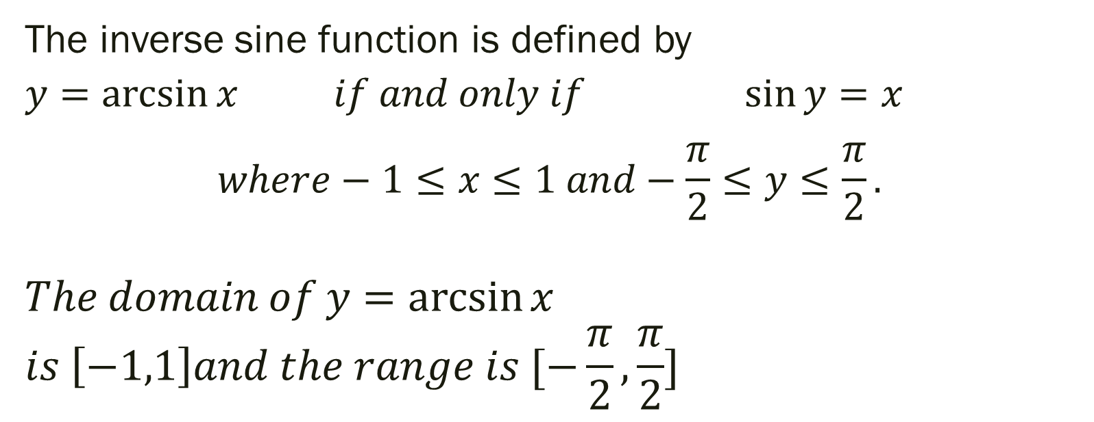
Definitions of Inverse Sine Function
The inverse sine function is defined by
$y=\arcsin{x}$ $if and only if$ $\sin{y}=x$ $$where−1≤x≤1 and−\frac{π}{2}≤y≤\frac{π}{2}.$$
$$The domain of y=\arcsin{x}$$
$$is \left[−1,1\right]and the range is [−\frac{π}{2}, \frac{π}{2}]$$

Slide 8

Examples: If possible, find the exact value.
$1.) arcsin\left(\frac{\sqrt{3}}{2}\right)$
${2.) sin}^{−1}\left(\frac{−1}{2}\right)$
${3.) sin}^{−1}\left(5\right)$

Slide 9
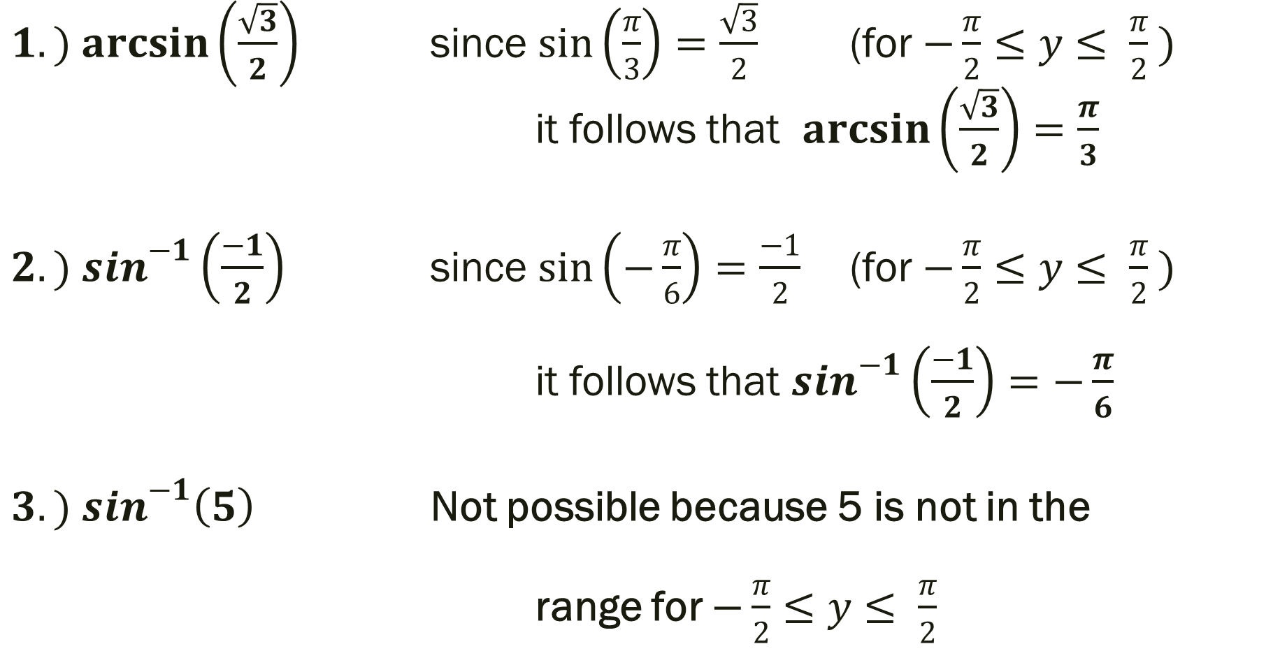
Examples: If possible, find the exact value.
$1.) arcsin\left(\frac{\sqrt{3}}{2}\right)$ since $\sin\left(\frac{π}{3}\right)=\frac{\sqrt{3}}{2}$ (for $−\frac{π}{2}≤y≤ \frac{π}{2} )$
it follows that $\arcsin\left(\frac{\sqrt{3}}{2}\right)=\frac{π}{3}$
${2.) sin}^{−1}\left(\frac{−1}{2}\right)$ since $\sin\left(−\frac{π}{6}\right)=\frac{−1}{2}$ (for $−\frac{π}{2}≤y≤ \frac{π}{2} )$
it follows that $\sin^{−1}\left(\frac{−1}{2}\right)=−\frac{π}{6}$
${3.) sin}^{−1}\left(5\right)$ Not possible because 5 is not in the
range for $−\frac{π}{2}≤y≤ \frac{π}{2}$

Slide 10
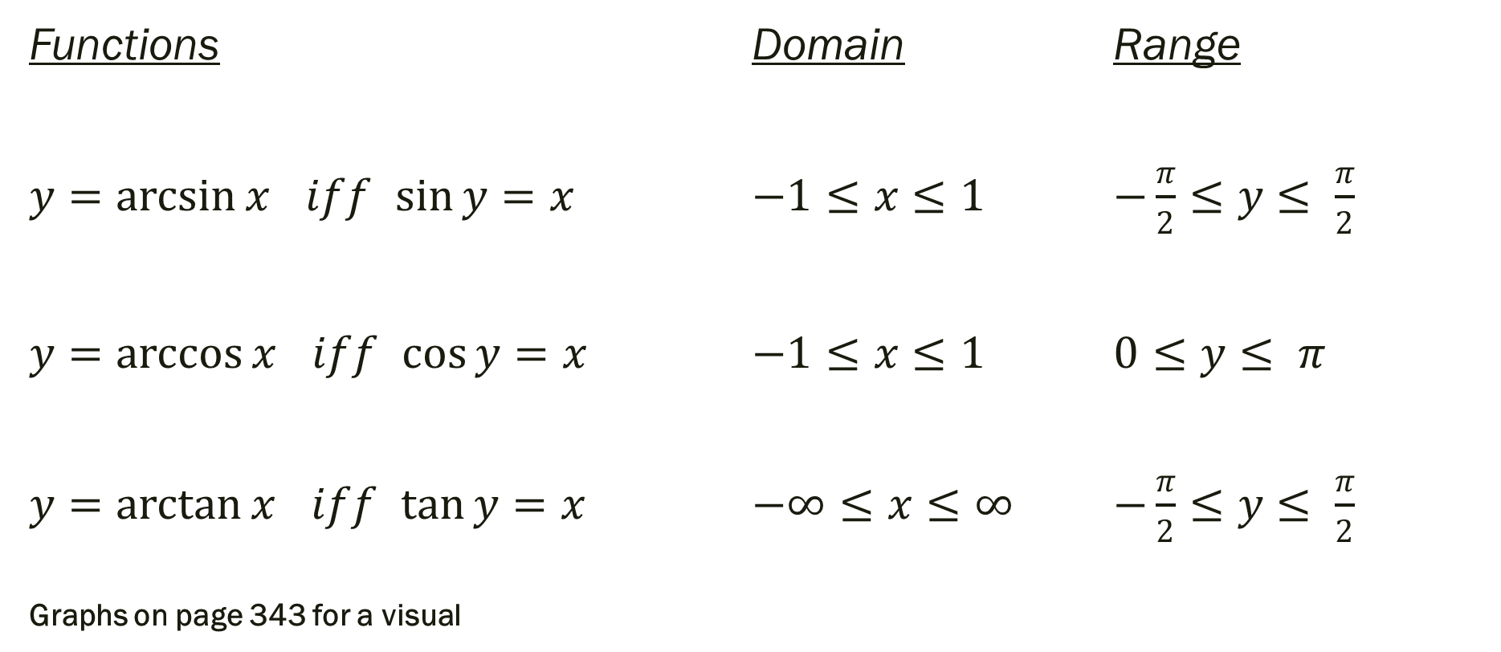
Definitions of the Inverse Trig Functions
Functions Domain Range
$y=\arcsin{x}$ $iff$ $\sin{y}=x$ $−1≤x≤1$ $−\frac{π}{2}≤y≤ \frac{π}{2}$
$y=\arccos{x}$ $iff$ $\cos{y}=x$ $−1≤x≤1$ $0≤y≤ π$
$y=\arctan{x}$ $iff$ $\tan{y}=x$ $−∞≤x≤∞$ $−\frac{π}{2}≤y≤ \frac{π}{2}$
Graphs on page 343 for a visual

Slide 11

Examples: If possible, find the exact value.
$1.) arccos\left(\frac{\sqrt{2}}{2}\right)$
${2.) cos}^{−1}\left(−1\right)$
${3.) tan}^{−1}\left(0\right)$

Slide 12
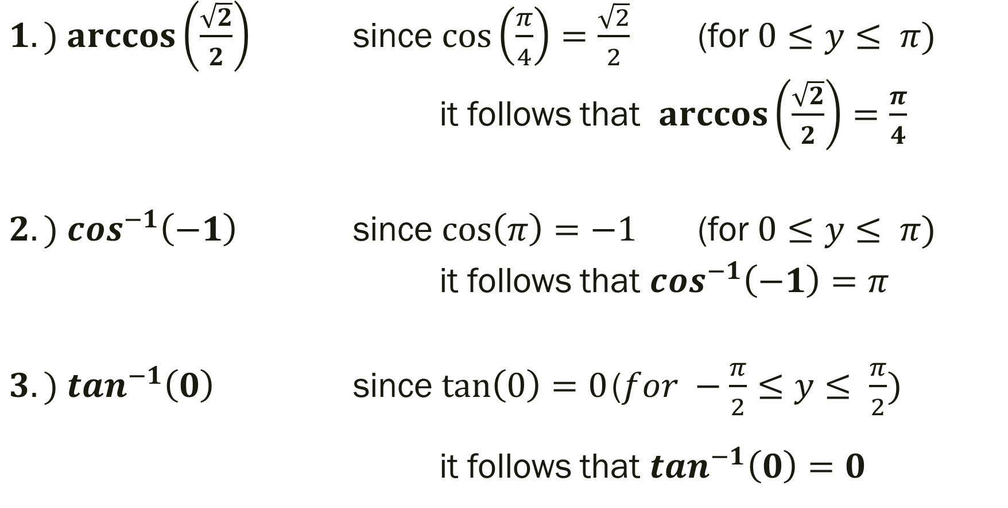
Examples: If possible, find the exact value.
$1.) arccos\left(\frac{\sqrt{2}}{2}\right)$ since $\cos\left(\frac{π}{4}\right)=\frac{\sqrt{2}}{2}$ (for $0≤y≤ π)$
it follows that $\arccos\left(\frac{\sqrt{2}}{2}\right)=\frac{π}{4}$
${2.) cos}^{−1}\left(−1\right)$ since $\cos\left(π\right)=−1$ (for $0≤y≤ π)$
it follows that $\cos^{−1}\left(−1\right)=π$
${3.) tan}^{−1}\left(0\right)$ since $\tan\left(0\right)=0$ ($for −\frac{π}{2}≤y≤ \frac{π}{2})$ it follows that $\tan^{−1}\left(0\right)=0$

Slide 13
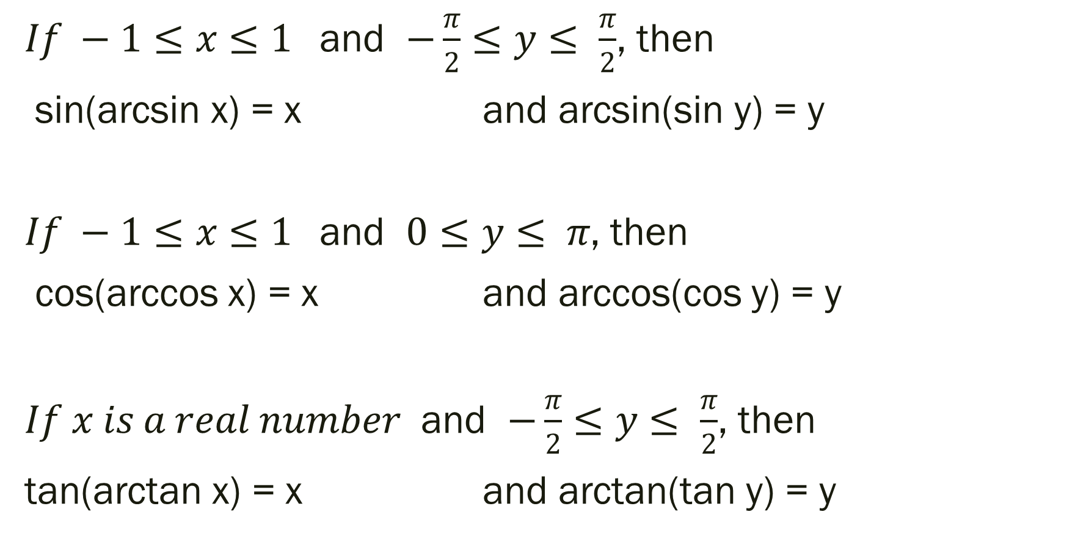
Inverse Properties of Trig Functions
$If −1≤x≤1$ and $−\frac{π}{2}≤y≤ \frac{π}{2}$, then
sin(arcsin x) = x and arcsin(sin y) = y
$If −1≤x≤1$ and $0≤y≤ π$, then
cos(arccos x) = x and arccos(cos y) = y
$If x is a real number$ and $−\frac{π}{2}≤y≤ \frac{π}{2}$, then
tan(arctan x) = x and arctan(tan y) = y

Slide 14
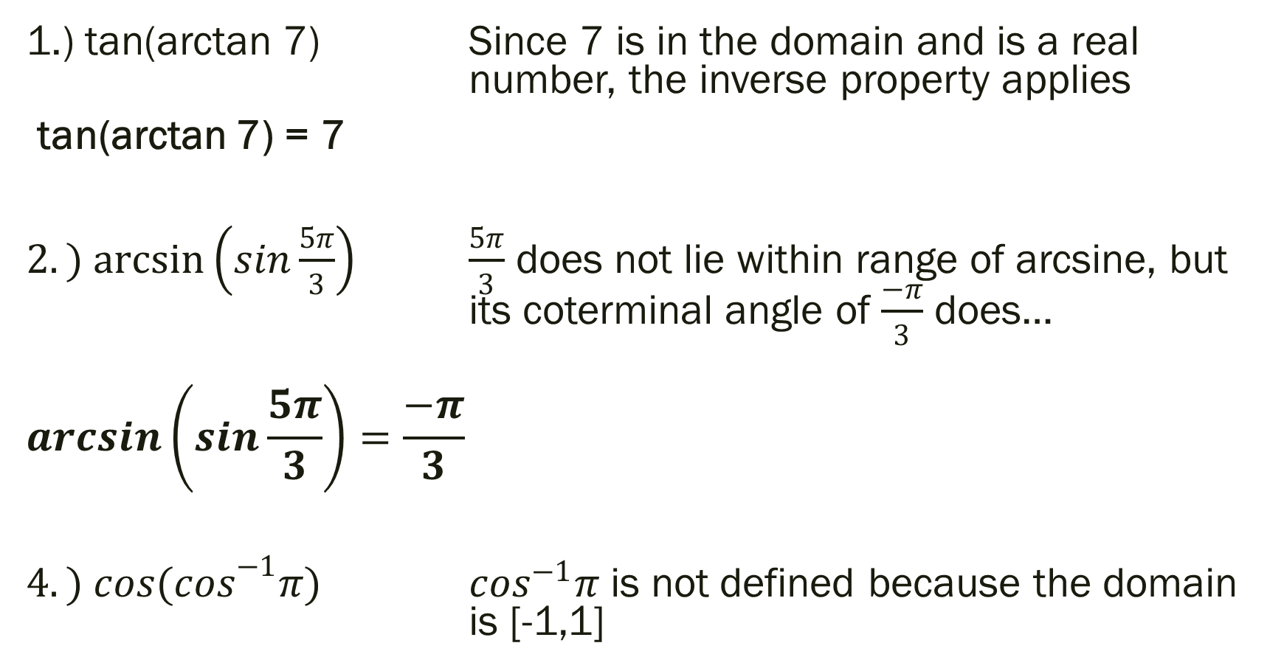
Examples: If possible, find the exact value.
1.) tan(arctan 7) Since 7 is in the domain and is a real number, the inverse property applies
tan(arctan 7) = 7
$2.) arcsin\left(sin\frac{5π}{3}\right)$ $\frac{5π}{3}$ does not lie within range of arcsine, but its coterminal angle of $\frac{−π}{3}$ does…
$$\arcsin\left(sin\frac{5π}{3}\right)=\frac{−π}{3}$$
$4.) {cos(cos}^{−1}π)$ $\cos^{−1}π$ is not defined because the domain is [-1,1]

Slide 15

Calculus Preview Examples:
Find the exact value.
$$1.) tan\left(arccos\frac{2}{3}\right)$$

Slide 16
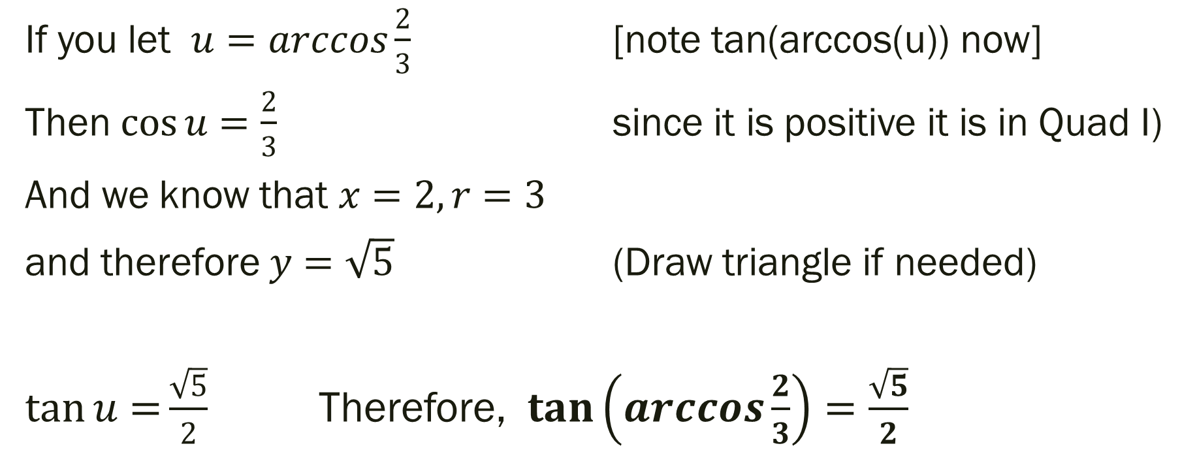
Solution
If you let $u=arccos\frac{2}{3}$ [note tan(arccos(u)) now]
Then $\cos{u}=\frac{2}{3}$ since it is positive it is in Quad I)
And we know that $x=2, r=3$
and therefore $y=\sqrt{5}$ (Draw triangle if needed)
$\tan{u=}\frac{\sqrt{5}}{2}$ Therefore, $\tan\left(arccos\frac{2}{3}\right)=\frac{\sqrt{5}}{2}$

Slide 17

Calculus Preview Examples:
Find the exact value.
$$2.) cos\left(\arcsin\left(\frac{−3}{5}\right)\right)$$

Slide 18
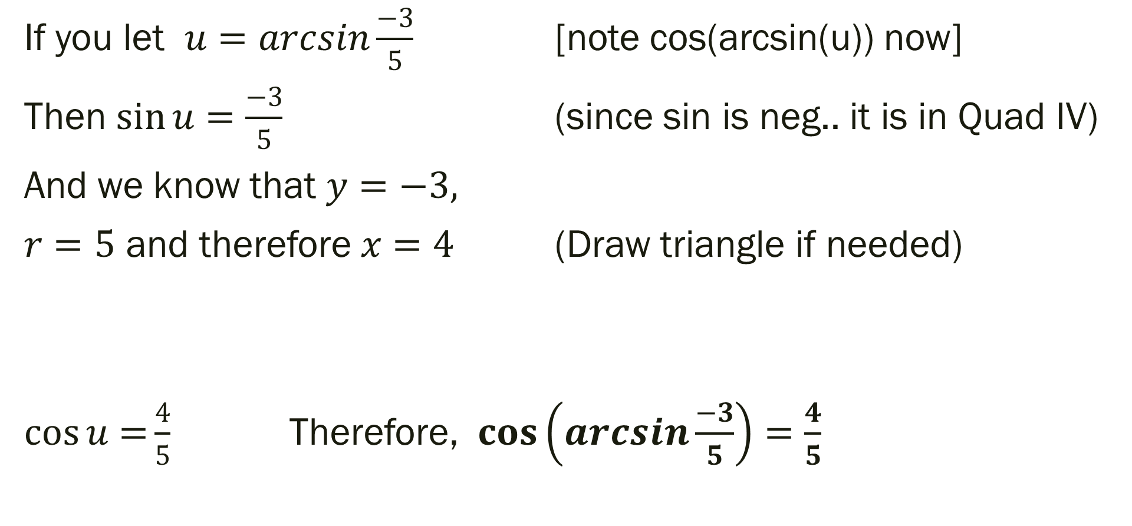
Solution
If you let $u=arcsin\frac{−3}{5}$ [note cos(arcsin(u)) now]
Then $\sin{u}=\frac{−3}{5}$ (since sin is neg.. it is in Quad IV)
And we know that $y=−3,$
$r=5$ and therefore $x=4$ (Draw triangle if needed)
$\cos{u=}\frac{4}{5}$ Therefore, $\cos\left(arcsin\frac{−3}{5}\right)=\frac{4}{5}$

Slide 19
4.8 Applications and Models
Objective: To Solve Real Life Problems Involving Right Triangles and Harmonic Motion

Slide 20
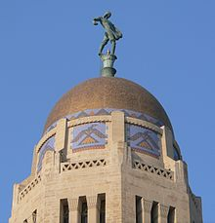
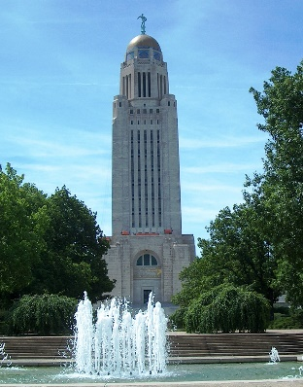
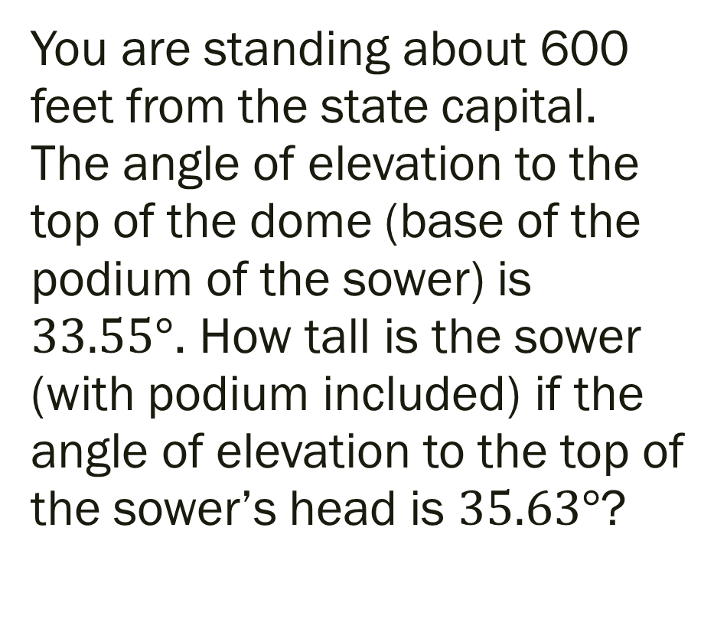
Example.
You are standing about 600 feet from the state capital. The angle of elevation to the top of the dome (base of the podium of the sower) is $33.55°$. How tall is the sower (with podium included) if the angle of elevation to the top of the sower’s head is $35.63°$?

Slide 21
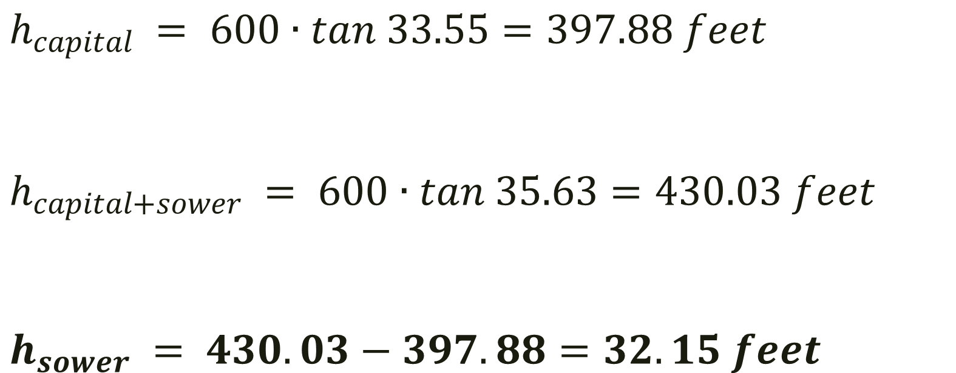
Solution
$$h_{capital} = 600∙tan 33.55=397.88 feet$$
$$h_{capital+sower} = 600∙tan 35.63=430.03 feet$$
$$h_{sower} = 430.03−397.88=32.15 feet$$

Slide 22
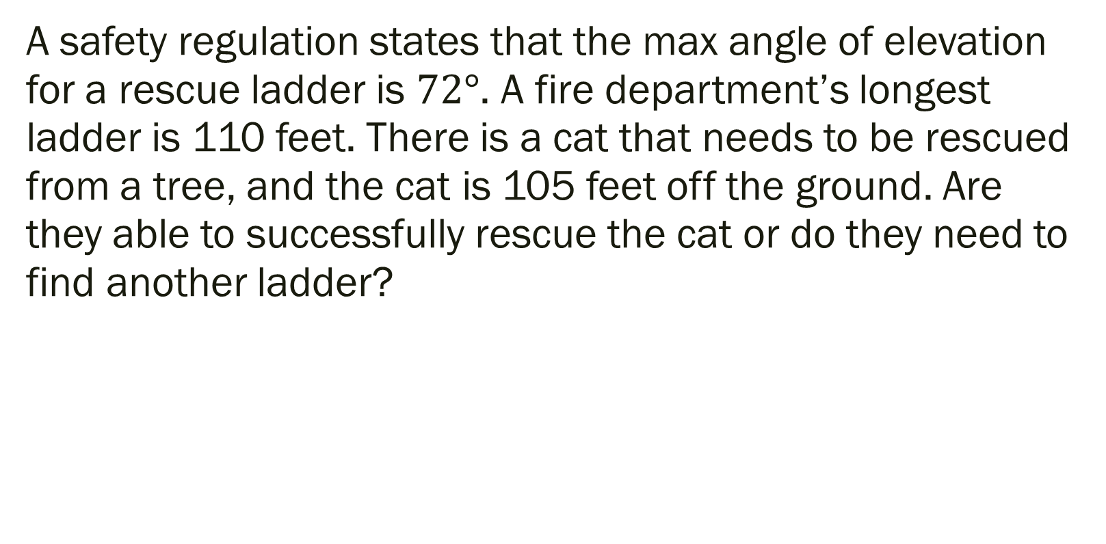
Additional Example
A safety regulation states that the max angle of elevation for a rescue ladder is $72°$. A fire department’s longest ladder is 110 feet. There is a cat that needs to be rescued from a tree, and the cat is 105 feet off the ground. Are they able to successfully rescue the cat or do they need to find another ladder?

Slide 23
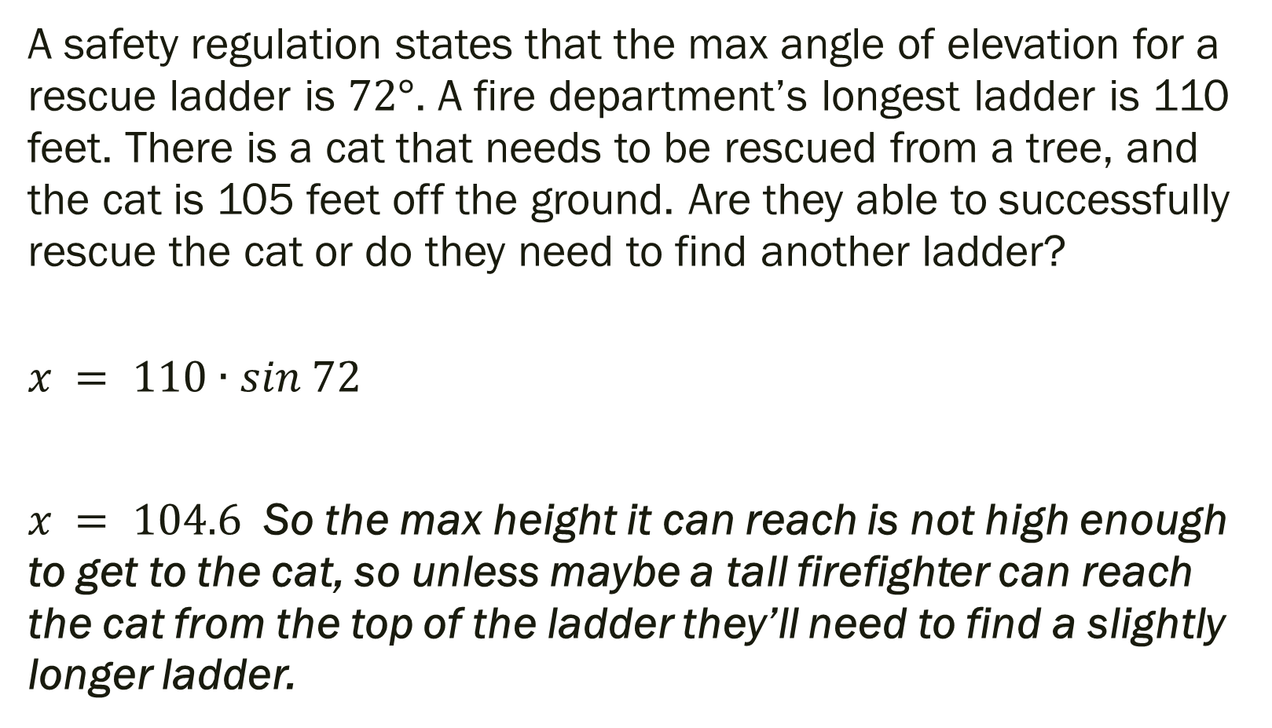
Solution
A safety regulation states that the max angle of elevation for a rescue ladder is $72°$. A fire department’s longest ladder is 110 feet. There is a cat that needs to be rescued from a tree, and the cat is 105 feet off the ground. Are they able to successfully rescue the cat or do they need to find another ladder?
$$x = 110∙sin 72$$
$x = 104.6$ So the max height it can reach is not high enough to get to the cat, so unless maybe a tall firefighter can reach the cat from the top of the ladder they’ll need to find a slightly longer ladder.

Slide 24
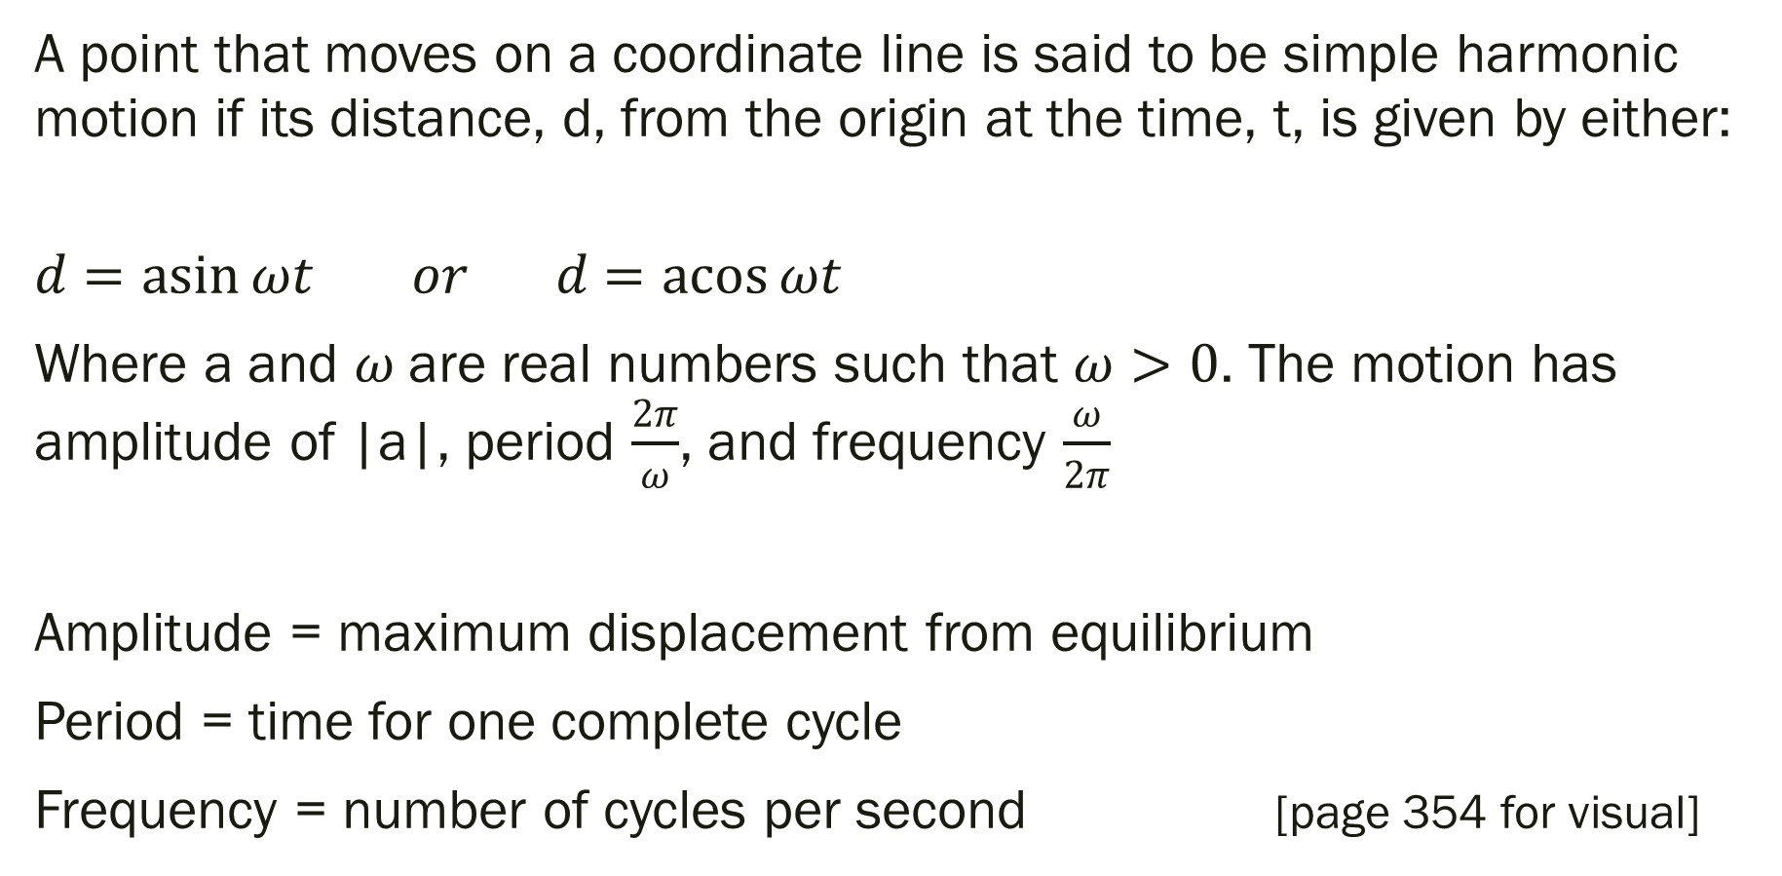
Definition of Simple Harmonic Motion
A point that moves on a coordinate line is said to be simple harmonic motion if its distance, d, from the origin at the time, t, is given by either:
$$d=\operatorname{asin}{ωt} or d=\operatorname{acos}{ωt}$$
Where a and $ω$ are real numbers such that $ω>0$. The motion has amplitude of |a|, period $\frac{2π}{ω}$, and frequency $\frac{ω}{2π}$
Amplitude = maximum displacement from equilibrium
Period = time for one complete cycle
Frequency = number of cycles per second [page 354 for visual]

Slide 25
Example
A ball is bouncing up and down on a spring. Suppose that 12 inches is the max distance the ball moves vertically (up or down) from its equilibrium (rest) position. Suppose the time it takes for the ball to move from its max displacement (above zero) to its min displacement (below zero) is 6 seconds.
Assuming perfect elasticity, no friction, and no air resistance, the ball would continue to move in a uniform motion. Find the amplitude, period, and frequency.

Slide 26
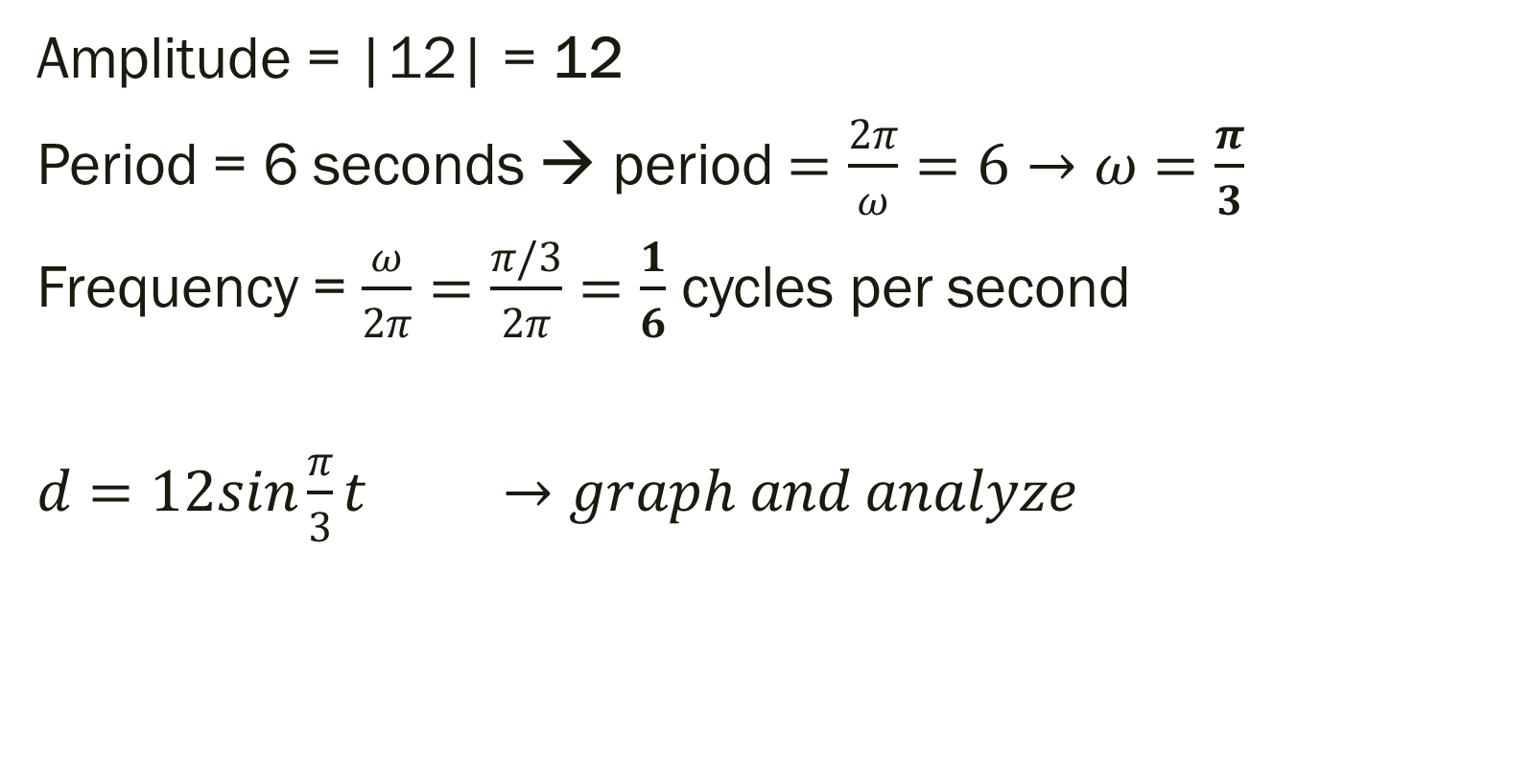
Solution
Amplitude = |12| = 12
Period = 6 seconds → period $=\frac{2π}{ω}=6→ω=\frac{π}{3}$
Frequency = $\frac{ω}{2π}=\frac{π/3}{2π}=\frac{1}{6}$ cycles per second
$d=12sin{\frac{π}{3}t} →graph and analyze$

Slide 27
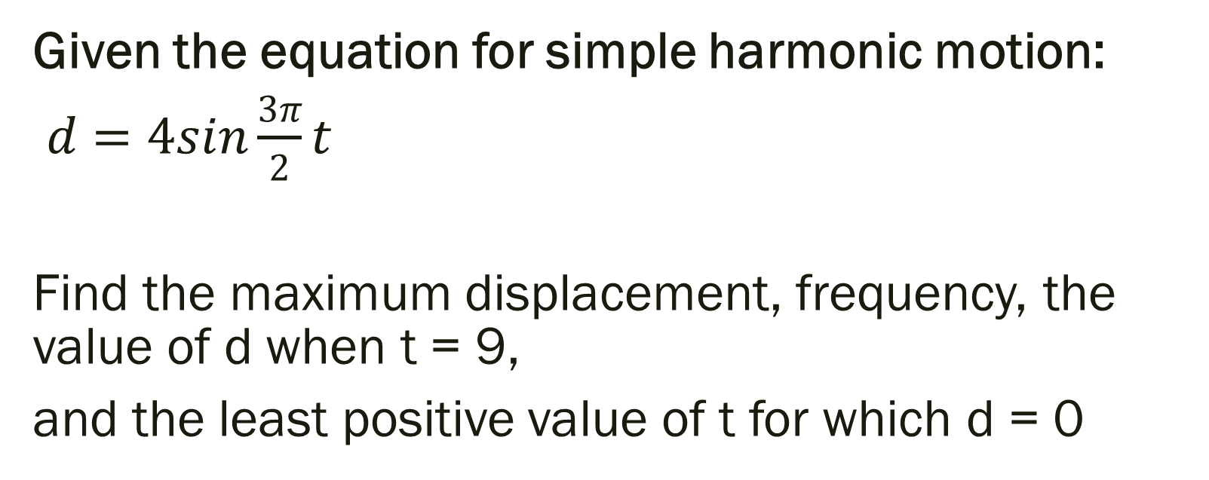
Example
Given the equation for simple harmonic motion:
$d=4sin{\frac{3π}{2}t}$
Find the maximum displacement, frequency, the value of d when t = 9,
and the least positive value of t for which d = 0

Slide 28
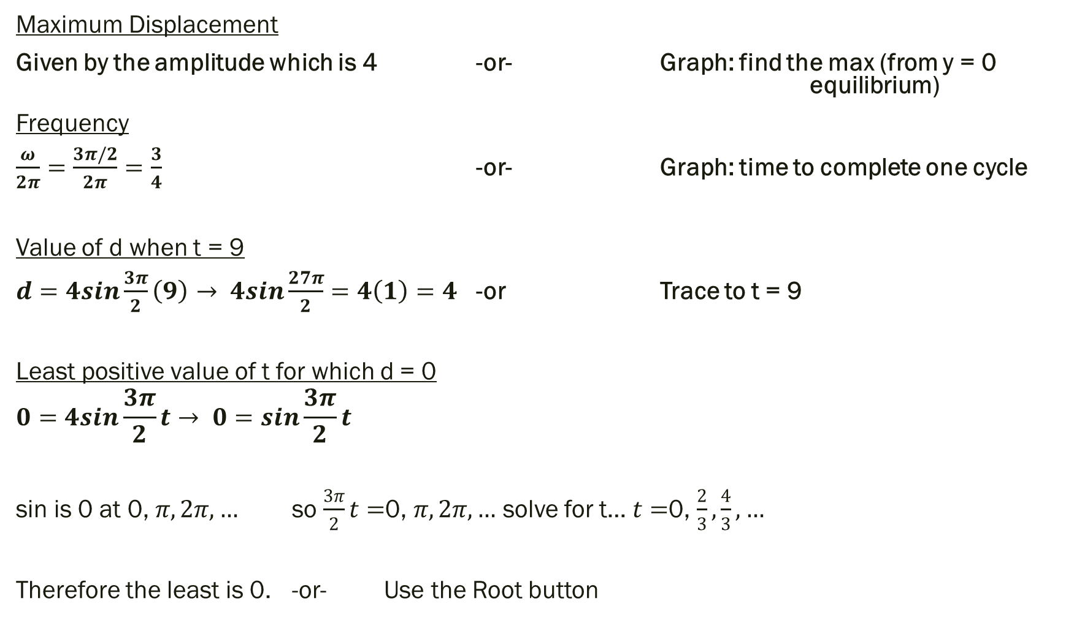
Solution
Maximum Displacement
Given by the amplitude which is 4 -or- Graph: find the max (from y = 0 equilibrium)
Frequency
$\frac{ω}{2π}=\frac{3π/2}{2π}=\frac{3}{4}$ -or- Graph: time to complete one cycle
Value of d when t = 9
$d=4sin{\frac{3π}{2}\left(9\right)→ 4sin{\frac{27π}{2}}}=4\left(1\right)=4$ -or Trace to t = 9
Least positive value of t for which d = 0
$$0=4sin{\frac{3π}{2}t}→ 0=\sin{\frac{3π}{2}t}$$
sin is 0 at 0, $π, 2π, …$ so $\frac{3π}{2}t=$0, $π, 2π, …$ solve for t… $t=$0, $\frac{2}{3}, \frac{4}{3}, …$
Therefore the least is 0. -or- Use the Root button

Slide 29
For Next Time
Page 347 #1-4, 5-9 (odd), 23-27 (odd), 43, 49-51, 55, 105, 111
Get a Head Start…
Page 357 #5, 17, 19, 21, 24, 33,
51, 54-56, 62-63

